Slide 1
Creating Compensation Statements Using IVEE – PR Version
Prepared for Southern Arizona IVEE User Group
October 3, 2013

Slide 2
Creating Compensation Statements
Why bother?
Setting up Compensation Statements
Other Benefits of Setting Up Compensation Statements

Slide 3
Why Bother?
Isn’t a Paycheck enough?
NO!
Notes:
A pay check is not enough anymore! Ask anyone who’s been at your school for a long time

Slide 4
Setting up Compensation Statements
Human Resources > Reports > Compensation Statements
Start by setting up your Compensation Statement Categories
These define salaries & benefits

Slide 5
Setting up Compensation Statements
Human Resources > Reports > Compensation Statements > Compensation Statement Categories
Add records to set up which items you want displayed and how

Slide 6
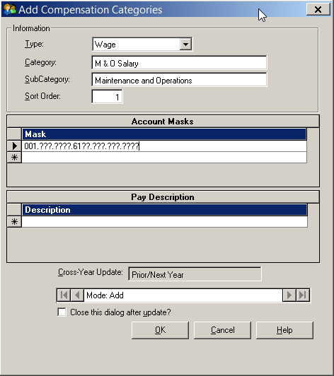
Setting up Compensation Statements
Add salary records to set up which items you want displayed and how.
Split up Salaries as desired (by fund, by pay description)

Slide 7
Setting up Compensation Statements
Breakdown salaries, be as specific or as general as you want

Slide 8
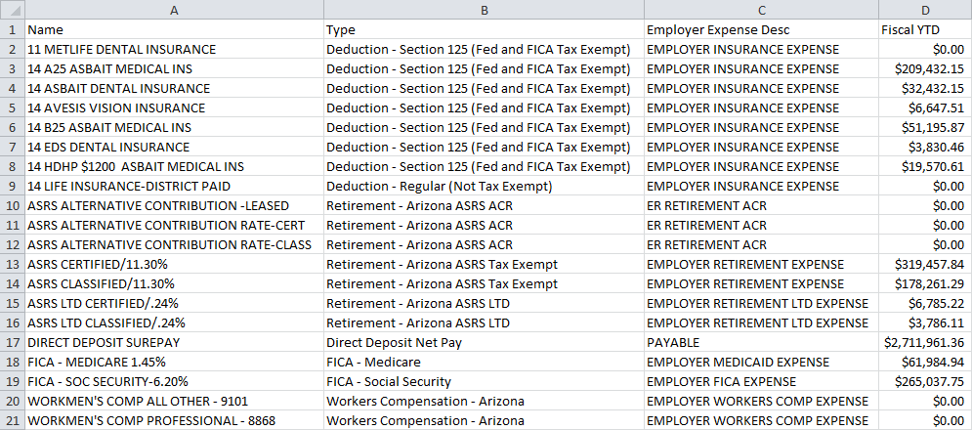
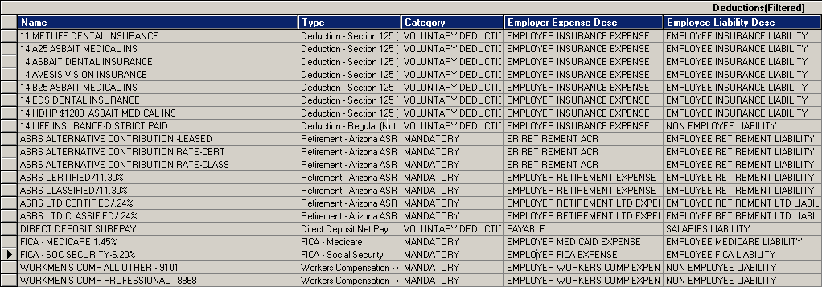
Setting up Compensation Statements
What benefits are Employer-Paid?
Filter your Deductions & Benefits Maintenance grid to locate your employer paid benefits
Export the grid to excel so you have a reference when inputting your Deduction Categories

Slide 9
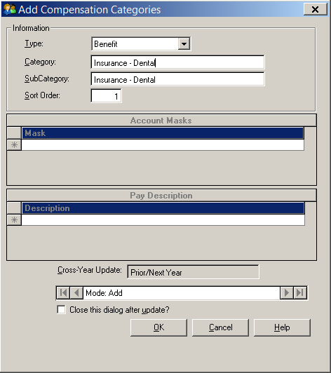
Setting up Compensation Statements
Add benefit records to set up which employer paid benefits you want displayed and how.
Split up Benefits for any employer paid portions
There are no account masks for Benefits

Slide 10
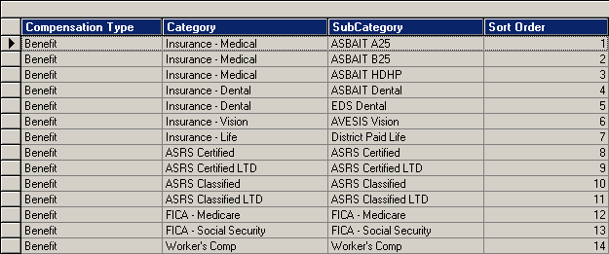
Setting up Compensation Statements
Add records for all your Employer Paid Benefits

Slide 11
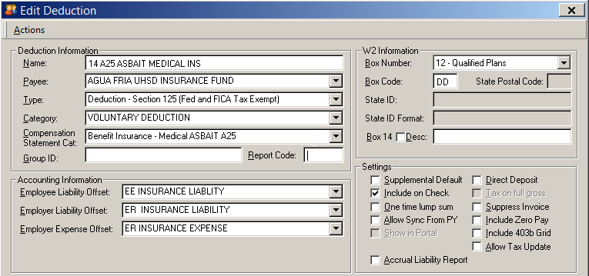
Setting up Compensation Statements
Deductions / Benefits Maintenance – Assign Compensation Statement Categories

Slide 12
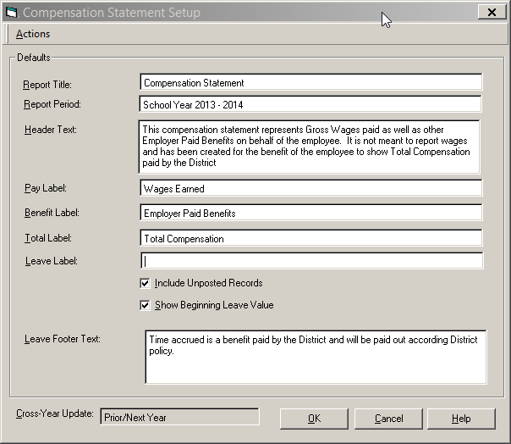
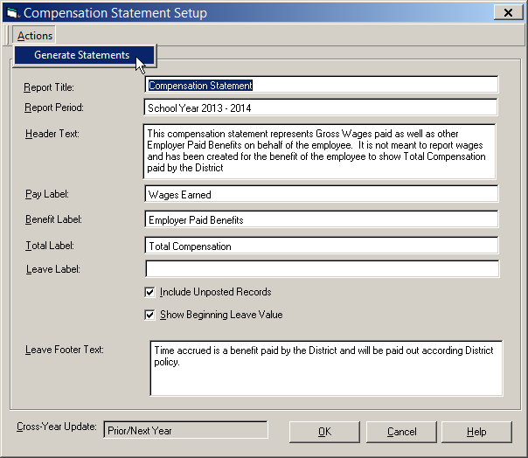
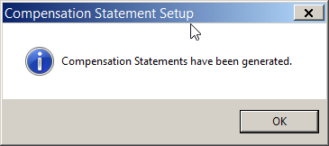
Setting up Compensation Statements
Human Resources > Reports > Compensation Statements > Compensation Statement Setup

Slide 13
Setting up Compensation Statements
Human Resources > Reports > Compensation Statements > Compensation Statement Summary
Summary grid shows all the categories you have set up for each employee.
Populated once you run the Action to Generate Statements

Slide 14
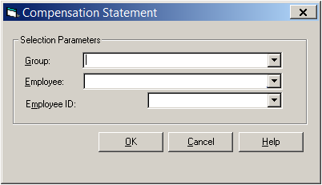
Setting up Compensation Statements
Human Resources > Reports > Compensation Statements > Compensation Statement
Now that you have the records generated, you can print the Compensation Statements!
Filter by Group, a specific employee, or run for everyone.

Slide 15
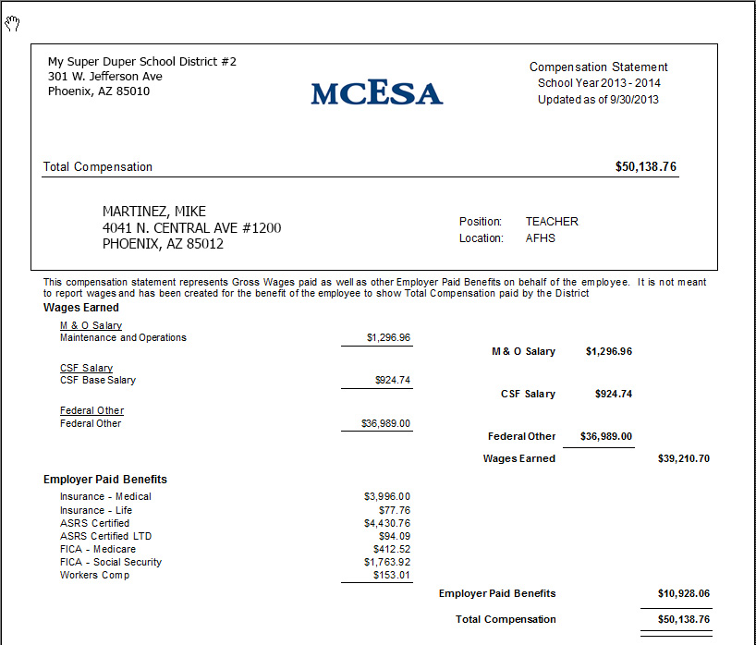

Slide 16
Other Benefits of Setting up Comp Statements
Employee Retention
Obtain a clearer picture of what employees cost
Forecast effects of payroll changes

Slide 17
Processing Payroll in the Encumbrance Period
Questions?

